Slide 1
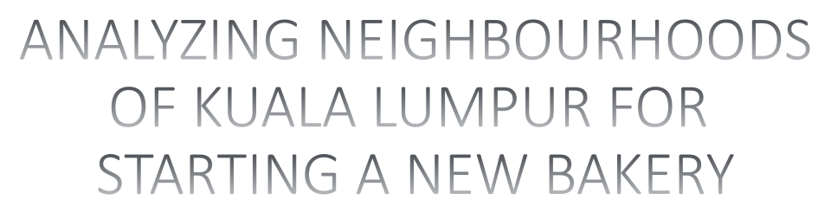


Slide 2

Kuala Lumpur, or KL, is the federal capital and most populous city of Malaysia.
an approximation population of 7.2 million in 2016 and now in 2020 estimated at 7,996,830.
Comprises of multi-ethnic cultures.
Malaysian market has seen positive growth of baked goods as more products are consumed at meal times in place of rice and noodles.

Slide 3

To select a best location for a opening of bakery in the neighbourhood of Kuala Lumpur .

Slide 4

To solve the problem, we will need the following data:
List of Kuala Lumpur neighbourhood
  use web scrapping
Geographical coordinates of neighbourhood
  using Geopy library
Venue data from Foursquare
  using Foursquare API

Slide 5

The data for venues retrieved from Foursquare within 2000 meter.
The data frame was transformed with the venues, associated to neighbourhood, by one-hot encoding (0/1).
Group rows by neighbourhood and by taking the mean of the frequency of occurrence of each category.
Create a data frame in which you can see the top 10 most common venue types for each neighbourhood.
K means clustering algorithm was implemented.
Elbow method was use to identify optimal value of clusters.

Slide 6
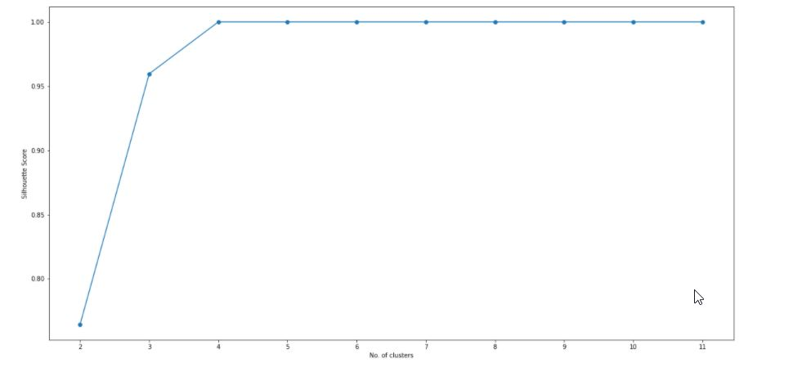
The plot show that the optimal number of clusters is 4.

Slide 7
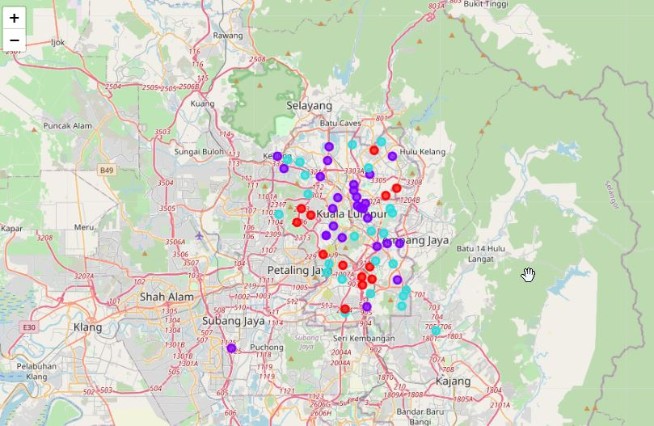
The neighbourhood marked with a cluster-specific color on a map.
After examining the all 4 individual clusters, some important conclusion was derived. The neighbourhood that have most number of bakeries is Cluster 1.

Slide 8

The most suitable neighbourhood to start a bakery are present in Cluster 1.
Less competition areas:
  Bandar Sri Permaisuri, Taman Desa, Sri Hartamas, Desa Petaling, Damansara Heights and Bukit Kiara.
Low cost area:
  Desa Petaling
  suitable location to start ‘Cloud Bakery’ or bakery without dining area.

Slide 9

Data science and machine learning techniques used in this project were very helpful to derived the results. We achieved the goal presented and the entrepreneurs or business peoples can see in the results which neighbourhood best match for their bakeries.

